Slide 1





EMOJIFY USING DEEP LEARNING
Group CS-24
Aayush Manoj Tirmalle (18BBTCS002)
Aman.G.Nair (18BBTCS008)
Hemanth Kumar B (18BBTCS042)
K.N. Prajwal Sai (18BBTCS0046)

Slide 2



OBJECTIVE
The aim of this project is to build a deep learning model to classify facial expressions from the images. Then we will map the classified emotion to an emoji or an avatar.
In this project we are able to detect the emotions on the person’s face in real time with the use of deep learning.

Slide 3

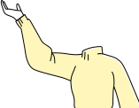
INTRODUCTION
Emojis or avatars are ways to indicate nonverbal cues. These cues have become an essential part of online chatting, product review, brand emotion, and many more. It also leads to increasing data science research dedicated to emoji-driven storytelling.
With advancements in computer vision and deep learning, it is now possible to detect human emotions from images. A person always wants his surroundings to be
according to his emotion.
Emojis are basically graphical representation of emotion.
Our software will be using these in order to make the working
more interactive and fun.

Slide 4


Literature Survey
When interacting via text-based communication, it can be difficult for speakers to convey their emotions due to the absence of non-linguistic cues such as facial expression and body language.
Face2Emoji , a system and method to use users’ facial emotional expressions as system input to ﬁlter emojis by emotional category.
Facial expression recognition plays a crucial role in the area of human-machine interaction. Automatic facial expression recognition system has many applications in various streams including medicine, E-Learning, monitoring, entertainment, law and marketing.
Therefore, a human emotion recognition system is very much needed to ease our lives in a future environment that will be fully automated and controlled by Artificial Intelligence and deep learning

Slide 5






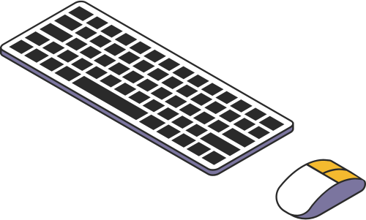

HARDWARE REQUIREMENTS
Device : PC or Laptop
Processor : Intel Core i3
or i5 8100 3.6 GHz.
Hard disk(storage) : 500 GB
RAM : 4 GB and above.
GPU: 4GB nvidia GeForce GTX
Keyboard and Mouse
Webcam

Slide 6






SOFTWARE REQUIREMENTS
Operating System: Windows8.0 or higher, Ubuntu
Programming language : Python
IDE : Visual Studio Code
FER 2013 Dataset: available from Kaggle is used for training the model to detect emotions.
Haar Cascade: haarcascade_frontalface_default.xml
is used for face detection
Libraries : Keras , Tensorflow , OpenCV, numPy
kaggle

Slide 7
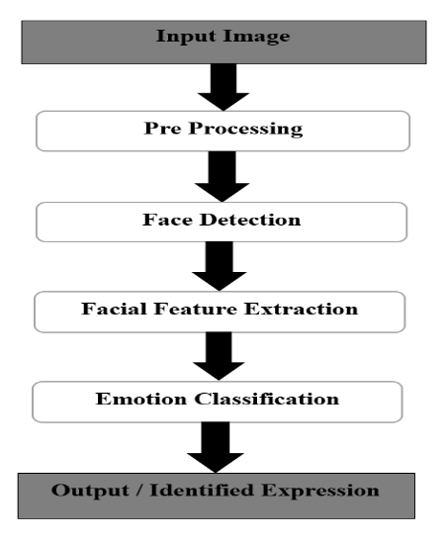
WORK FLOW

Slide 8

ALGORITHM
STEP 1: START
STEP 2: Load data from the prepared FER 2013 dataset, available in kaggle.
STEP 3: Train dataset and validate it
STEP 4: Run train.py and CNN model is trained.
STEP 5: Run gui.py and the trained model is loaded.
STEP 6: Open camera , load HaarCascade classifier for face detection.
STEP 7: When face is detected , bounded box is generated on the face and the
emotion is detected.
STEP 8: The emoji mapped to the detected facial expression is printed on the terminal.
STEP 9: Emoji is formed in real time.
STEP 11: END.

Slide 9




LET's Begin Demo

Slide 10
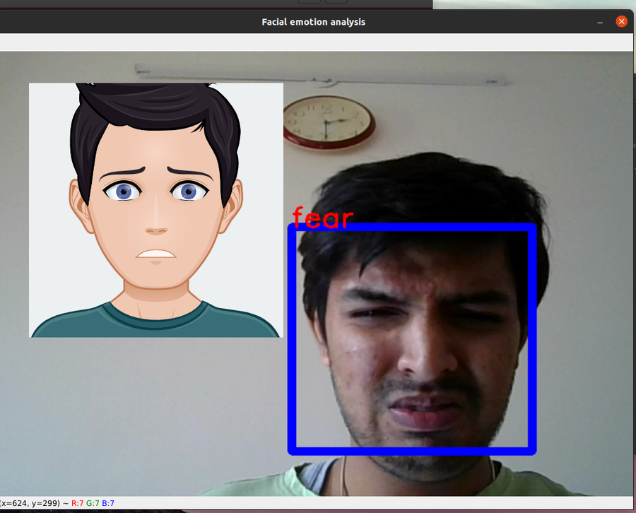
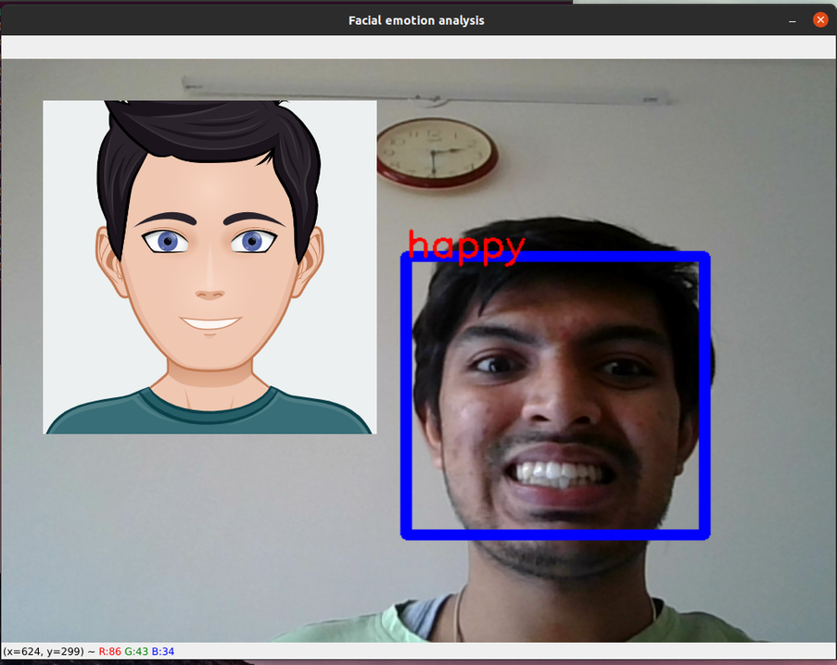
SCREENSHOTS OF RESULT

Slide 11










APPLICATIONS
In recent years, the use of facial expression recognition systems or softwares have been increasing. There are many applications of this project:
Used as a filter in social media apps such as instagram , facebook, snapchat ,etc.
Health and Medicine: In the field of health, this product can help in many methods. In every aspect of health care, it can be used to determine the emotions of a patient undergoing a surgery or a treatment process and notify the respective doctor about them. Using them as a basis a doctor can advise a better treatment suitable for the patient and thus easing out the difficulties or pain for them.
Psychology: It is the scientific study of the human mind and its functions, and it is done for the purpose of education or research including the medicinal part. This product has a lot of uses in the field of psychology as psychology is very closely related to emotions.
Lie Detection: The machine developed for lie detection uses the sensors to find any abnormality in the blood flow streams of the user.
Education: This product can be used to measure real-time learner responses and engagement with their educational content and thus adapt, personalize the content and measure effectiveness of lecturer.

Slide 12

FUTURE ENHANCEMENT
The model needs to be trained more so that it becomes capable of detecting all human emotions. At the same time, the accuracy of the software is also aimed to improve.

Slide 13
CONCLUSION
So finally, our project is capable of successfully recognizing the expressions/emotions of human beings. It is working in a good condition and can be used for real time situations without any problems. It has some drawbacks which can be very easily overcome by training our model with more dataset. Also, it is giving us proper emojis for making the session more interactive.

Slide 14



Thank
you!

